Slide 1
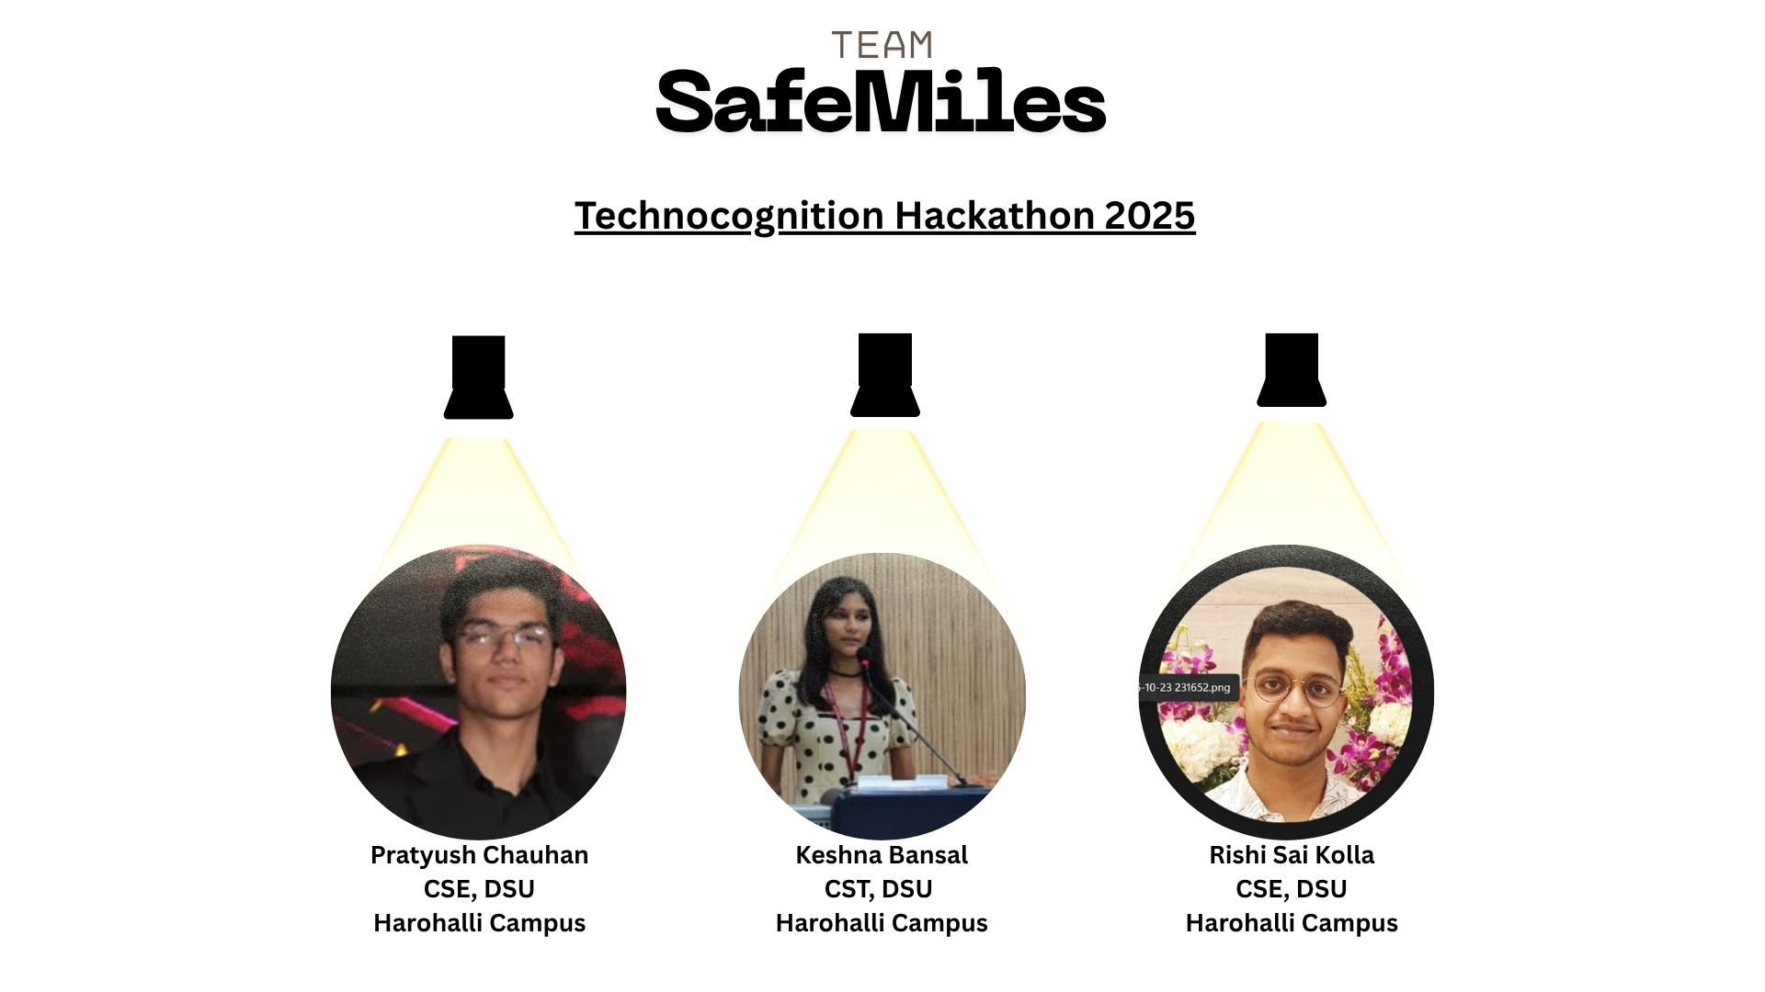


TechnoCognition'25

Slide 2

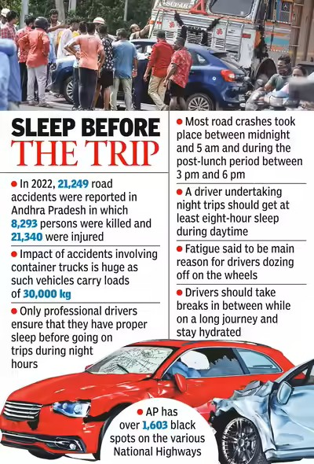
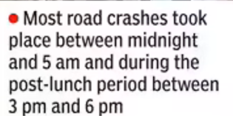
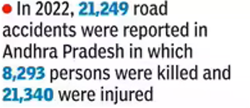
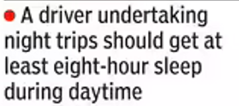
PROBLEM STATEMENT
ISSUE 1
ISSUE 2
ISSUE 3
20% of vehicle crashes are fatigue & dozing related.
Proof: https://pmc.ncbi.nlm.nih.gov/articles/PMC10082604/
Micro-sleep / brief dozing can occur in “the blink of an eye” and be deadly.
Proof: https://abcnews.go.com/Technology/blink-eye-dozing-driving/story?id=17870880
High risk among truck, cab & night-shift drivers
Existing systems are expensive or unavailable in low-end vehicles
@Electroblitz Club-Department of Electronics and Communication- Dayananda Sagar University
TechnoCognition'25

Slide 3

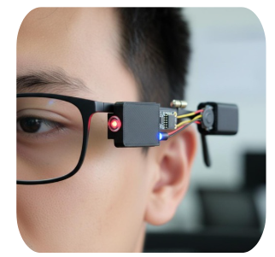
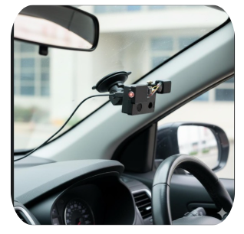

SOLUTION OVERVIEW
Detects eye blinks & head tilt in real time
Vibration & loud buzzer alert to wake driver instantly
Lightweight, discreet & comfortable
Buzzer alert when fatigue detected
GSM module sends SMS to ring/emergency contacts
Ideal for truck & long-distance drivers
1
1
2
2
3
3
TechnoCognition'25

Slide 4
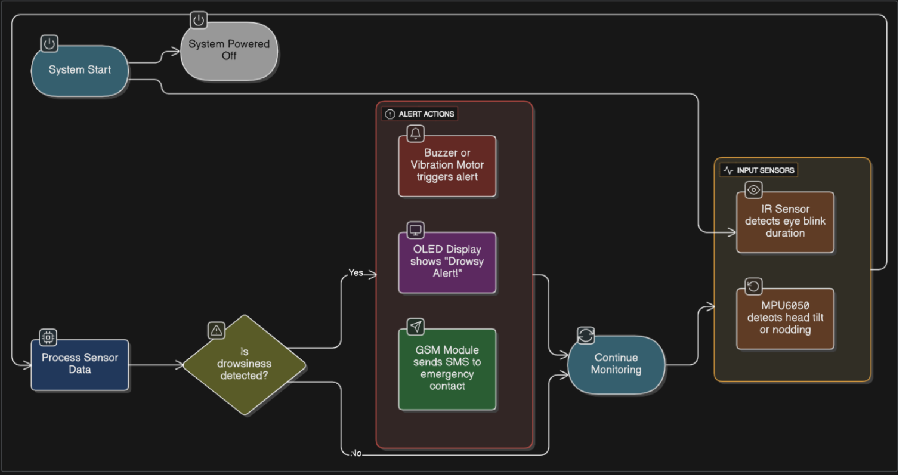
IMPLEMENTATION/PROTOTYPE
Cost = ₹600 to 800 total
IR Sensor
MPU6050
ESP32 / Arduino
Buzzer / Vibrator Motor
OLED Display (future)
GSM Module (future)
TechnoCognition'25

Slide 5
TECHNOLOGY STACK
TYPE
FUNCTION
ESP32 / Arduino
Microcontroller
Sensor processing
IR Sensor
Hardware
Eye-blink detection
MPU6050
Hardware
Head tilt sensing
Buzzer / Motor
Hardware
Driver alert
GSM Module
Hardware
SMS notification
OLED Display
Hardware
Visual indicator
Arduino IDE / C
Software
Code & logic control
TechnoCognition'25

Slide 6
IMPACT & SCALABILITY
Highlight the potential benefits, measurable outcomes, and how the solution can scale globally.
Reduces fatigue-related accidents drastically
Can be used in many vehicles – trucks, buses, cabs, etc.
Fleet version: Track multiple drivers from one dashboard
IoT upgrade: Can send safety data to the cloud in future
Car companies can build it in or use it as an add-on kit
Easy to improve: Sensors and modules can be upgraded anytime
Safety data can help insurance companies or road planners
Useful for government safety programs and CSR initiatives
Can be expanded globally with small design changes
Can integrate with AI-based facial recognition in future
Protects truck, cab, and delivery drivers
Real-World Impact
Scalable to fleet monitoring & smart vehicles
Extremely affordable and portable (~₹600–800)
Works offline – no internet required
TechnoCognition'25

Slide 7
RESULTS FUTURE SCOPE
Detects eye closure >3s head tilt >15°
Triggers alert in under 1 second
Portable, low-power setup tested on mock drive
SafeMiles
AI-based camera detection system
Cloud & app integration for fleet analytics
Multi-sensor fusion for accuracy
TechnoCognition'25

